Slide 1




Enhancing Traceability Link Recovery with Unlabeled Data
The 33rd IEEE International Symposium on Software Reliability Engineering
(ISSRE 2022)
Jianfei Zhu∗, Guanping Xiao∗†⋆, Zheng Zheng‡, Yulei Sui§
∗College of Computer Science and Technology, Nanjing University of Aeronautics and Astronautics, China
†State Key Laboratory of Novel Software Technology, Nanjing University, China
‡School of Automation Science and Electrical Engineering, Beihang University, China
§School of Computer Science, University of Technology Sydney, Australia
Charlotte, North Carolina, USA (Online)
2022-11-01

Slide 2
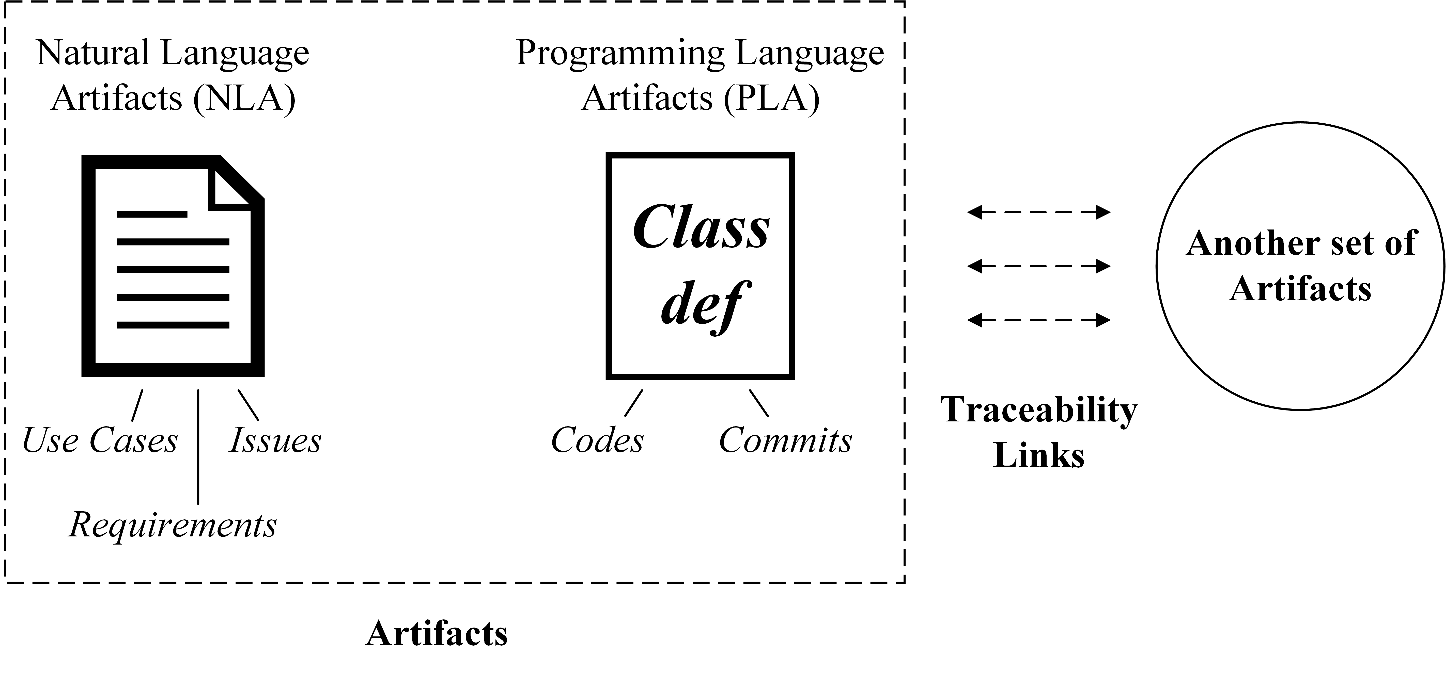
1. Traceability Link Recovery
Traceability link recovery (TLR) is a software engineering task that recovers links between different types of software artifacts.

Slide 3
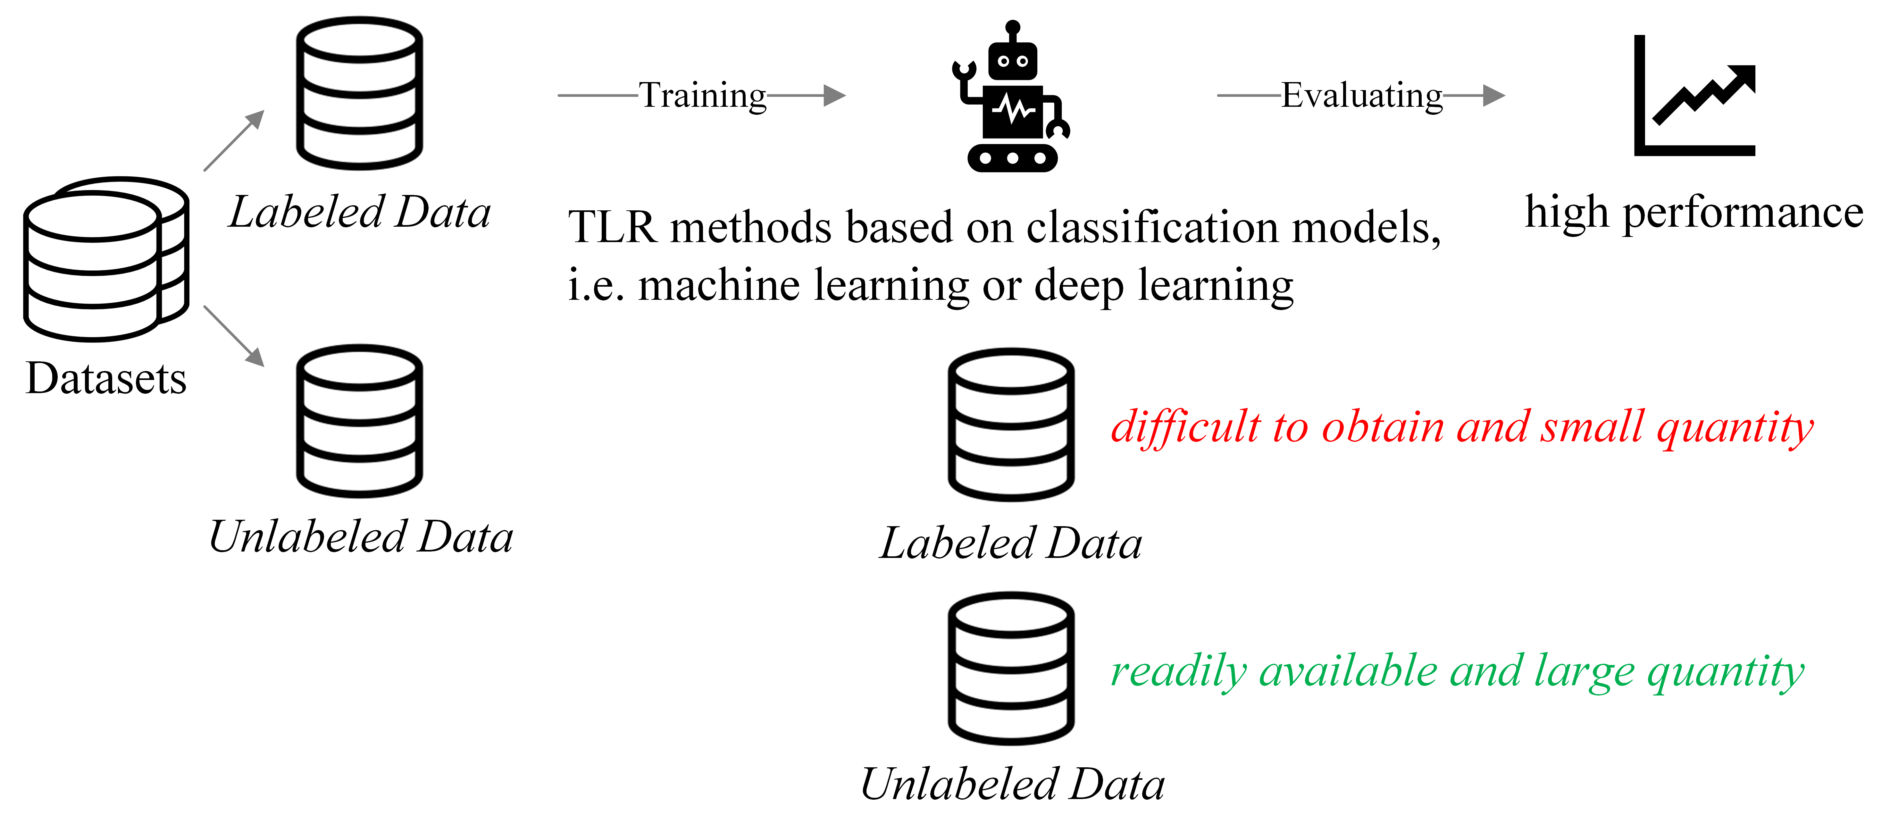
1. Traceability Link Recovery (Cont.)

Slide 4
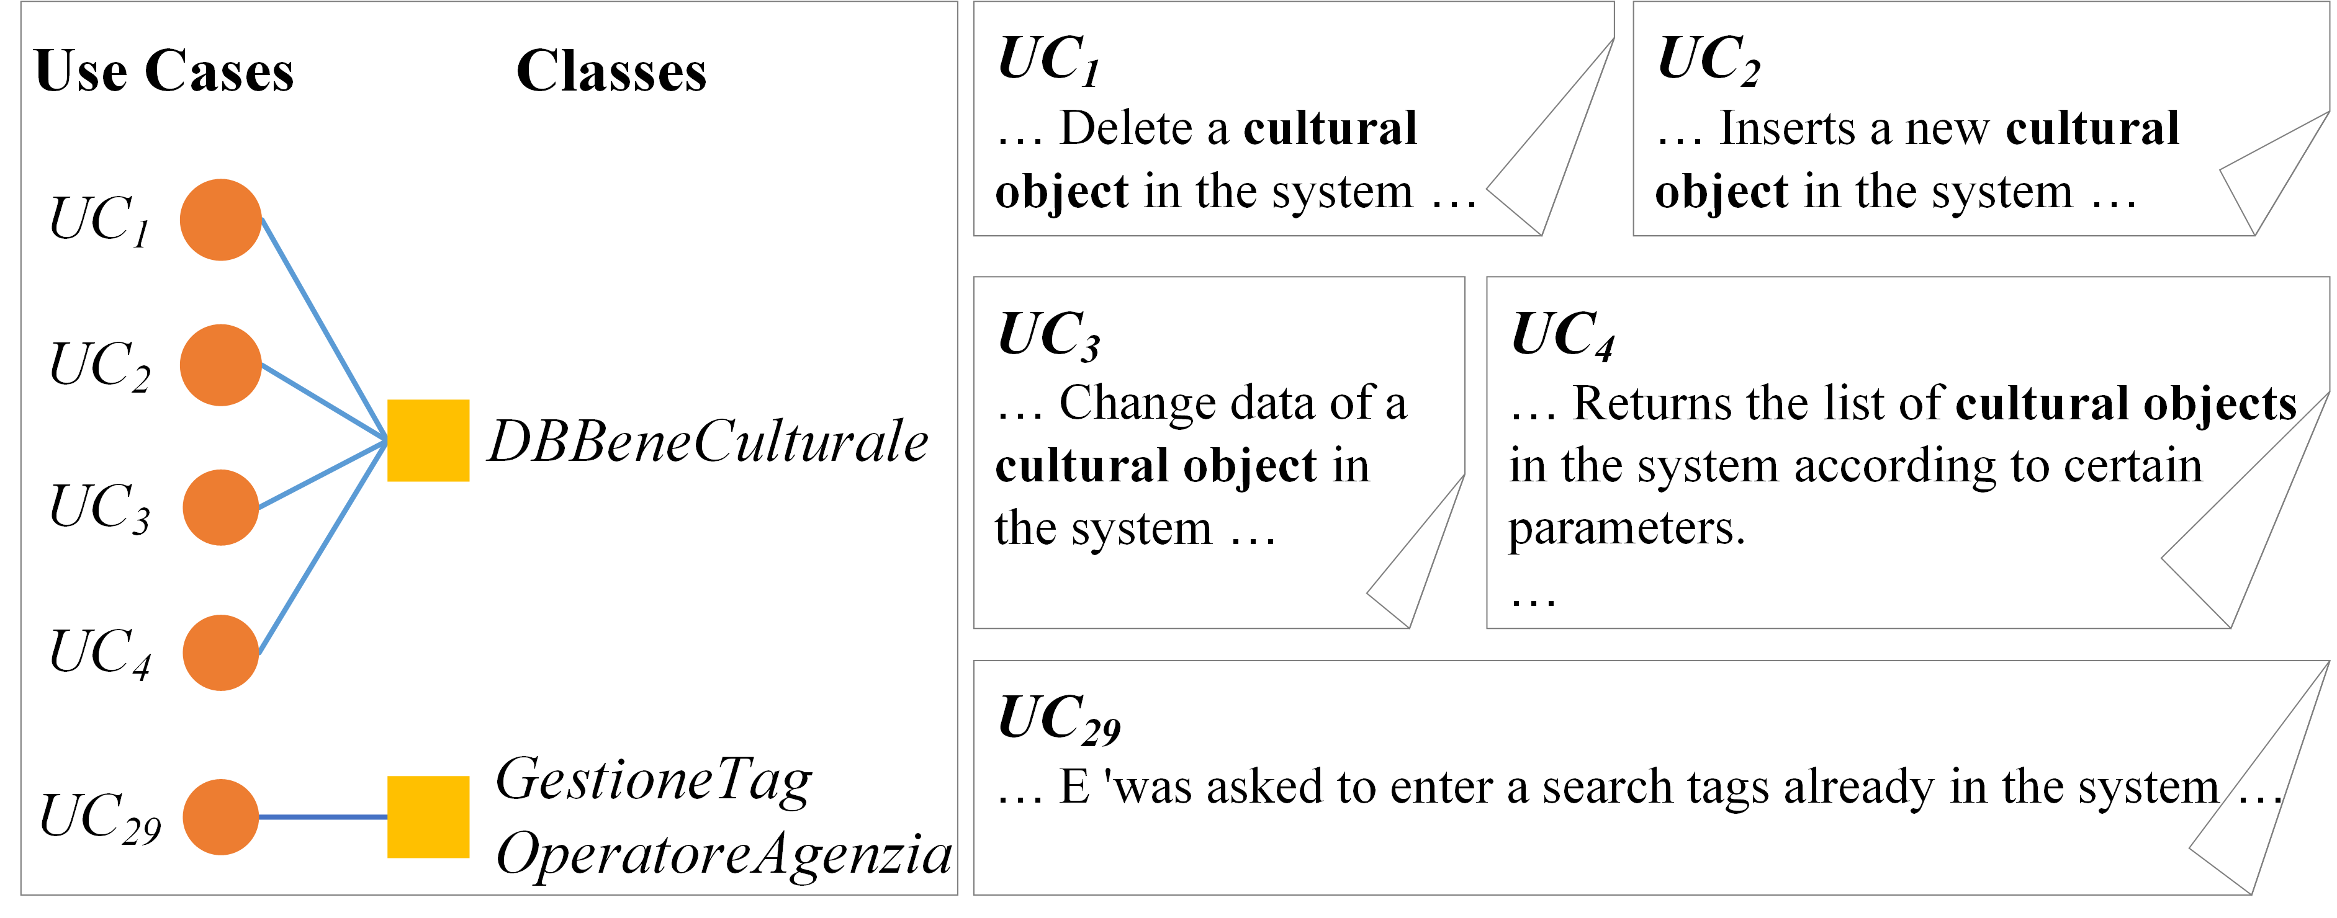
2. Motivating Example
This is a real-world traceability link example in the eTOUR project. There is a link between use case 1 to 4 and the class DBBeneCulturale and there is no link between use case 29 and the class DBBeneCulturale.
The following table is the result of calculating text similarity between use cases by VSM. High similarity between use cases linked to the same target class.
Has Common Target Artifact |  | No Common Target Artifact
Use Case | Similarity | Use Case | Similarity
(UC₁, UC₃) | 0.646 | (UC_{4 ,} UC₂₉) | 0.162
(UC₂, UC₃) | 0.556 | (UC_{3 ,} UC₂₉) | 0.142
(UC₁, UC₂) | 0.419 | (UC_{1 ,} UC₂₉) | 0.138
(UC₃, UC₄) | 0.347 | (UC_{2 ,} UC₂₉) | 0.123
(UC₂, UC₄) | 0.328
(UC_{1 ,} UC₄) | 0.257

Slide 5
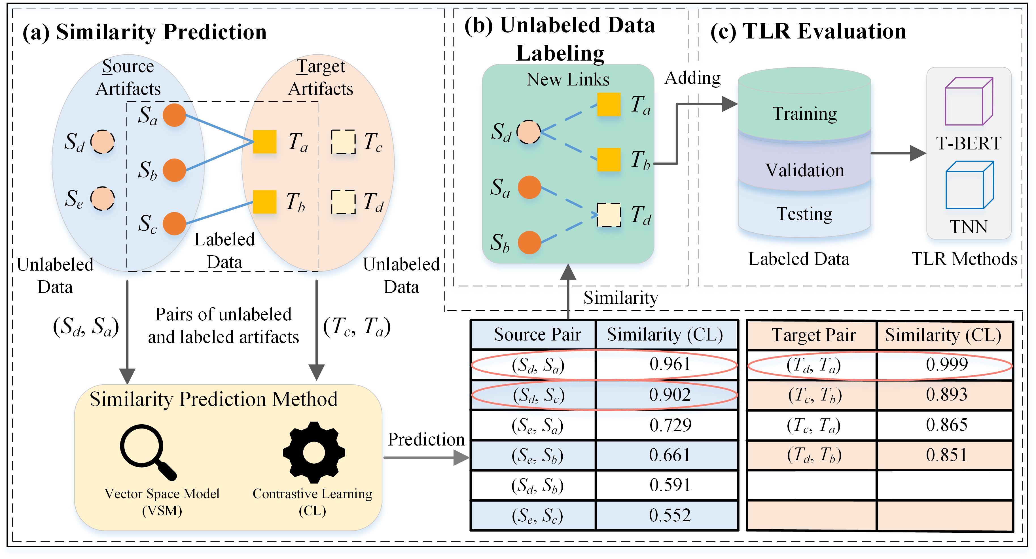
3. Our Solution
The TraceFUN framework mainly consists of three parts: similarity prediction, unlabeled data labeling and TLR evaluation.
Overview of TraceFUN

Slide 6
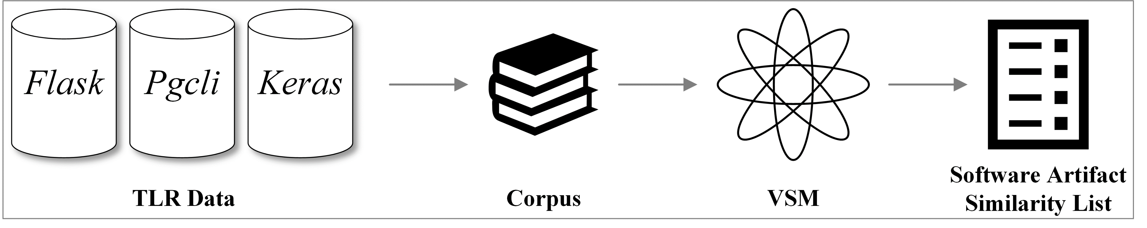
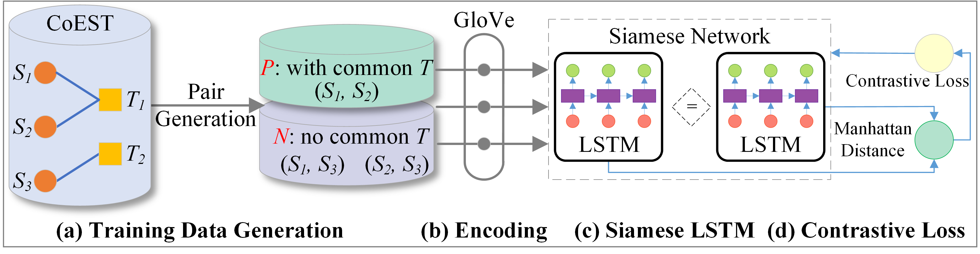
4. Our TraceFUN Approach
(1) Similarity Prediction Method
Vector Space Model (VSM)
Contrastive Learning (CL)

Slide 7
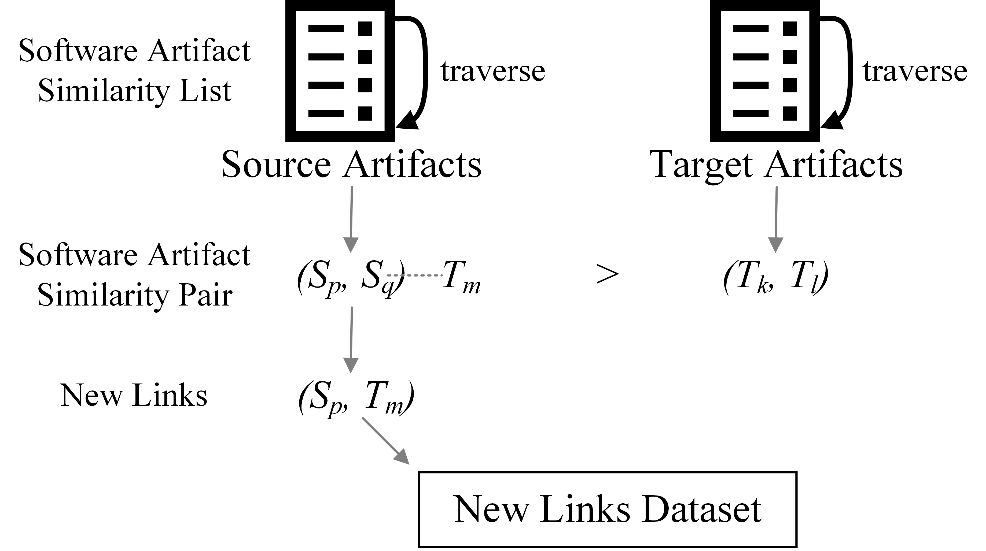
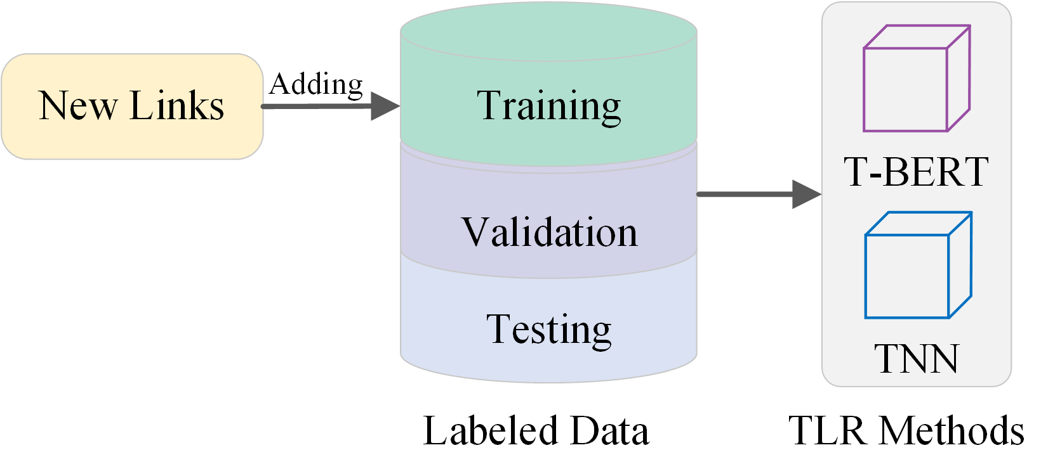
4. Our TraceFUN Approach (Cont.)
(2) Unlabeled Data Labeling
(3) TLR Evaluation

Slide 8
5. EXPERIMENT SETUP
Dataset for CL Training: 15 datasets provided by CoEST [46].
Dataset for TraceFUN Evaluation: issue-commit links are collected from [2], includes Flask, Pgcli, and Keras.
Settings for TLR Methods:
TNN [26], ICSE 2017
T-BERT [27], ICSE 2021
Evaluation Metrics:
F1-Score
F2-Score
Mean Average Precision (MAP)
Experiment Environments:
Python 3.8, TensorFlow 2.6.0 and Keras
Intel(R) Xeon(R) CPU E5-2678 v3 @ 2.50GHz
NVIDIA GeForce RTX 2080Ti GPU

Slide 9
6. Research Questions
RQ1: Can TraceFUN improve TLR performance?
RQ2: What’s the impact of different similarity prediction methods used in TraceFUN on TLR performance?
RQ3: What’s the impact of different sizes of newly labeled links generated by TraceFUN on TLR performance?

Slide 10
7. Results-RQ1
RQ1: Can TraceFUN improve TLR performance?
F1-Score of T-BERT with 50% new data trained by TraceFUN
Project | Original | VSM | CL | Random
Falsk | 0.644 | 0.718 (12%) | 0.713 (11%) | 0.576 (-11%)
Pgcli | 0.737 | 0.765 (4%) | 0.769 (4%) | 0.638 (-13%)
Keras | 0.945 | 0.910 (-4%) | 0.920 (-3%) | 0.882 (-7%)
Answer: TraceFUN can significantly improve TLR performance. TraceFUN is able to capture the semantically similar relationships between unlabeled and labeled artifacts, thereby generating effective newly labeled links for TLR model training.
F1-Score of TNN with 50% new data trained by TraceFUN
Project | Original | VSM | CL | Random
Falsk | 0.033 | 0.149 (351%) | 0.164 (396%) | 0.022 (-35%)
Pgcli | 0.036 | 0.148 (311%) | 0.181 (403%) | 0.039 (8%)
Keras | 0.032 | 0.066 (106%) | 0.042 (33%) | 0.028 (-13%)
Note that the displayed results are partially selected from our paper.
For full results, please refer to our paper.

Slide 11
7. Results-RQ2
RQ2: What’s the impact of different similarity prediction methods used in TraceFUN on TLR performance?
F1-Score of T-BERT trained by TraceFUN
Project | Original | 5% |  | 20% |  | 50% |  | 80% |  | 110%
 | Ori | VSM | CL | VSM | CL | VSM | CL | VSM | CL | VSM | CL
Flask | 0.644 | 0.667 | 0.654 | 0.682 | 0.671 | 0.718 | 0.713 | 0.759 | 0.757 | 0.778 | 0.763
Pgcli | 0.737 | 0.737 | 0.734 | 0.767 | 0.757 | 0.765 | 0.769 | 0.810 | 0.714 | 0.817 | 0.697
Keras | 0.945 | 0.939 | 0.940 | 0.936 | 0.938 | 0.910 | 0.920 | 0.895 | 0.910 | 0.866 | 0.889
F1-Score of TNN trained by TraceFUN
Project | Original | 5% |  | 20% |  | 50% |  | 80% |  | 110%
 | Ori | VSM | CL | VSM | CL | VSM | CL | VSM | CL | VSM | CL
Flask | 0.033 | 0.031 | 0.035 | 0.063 | 0.064 | 0.149 | 0.164 | 0.210 | 0.331 | 0.306 | 0.392
Pgcli | 0.036 | 0.047 | 0.044 | 0.082 | 0.074 | 0.148 | 0.181 | 0.233 | 0.182 | 0.295 | 0.203
Keras | 0.032 | 0.041 | 0.038 | 0.052 | 0.038 | 0.066 | 0.042 | 0.061 | 0.033 | 0.067 | 0.041
Note that the displayed results are partially selected from our paper.
For full results, please refer to our paper.

Slide 12
7. Results-RQ2 (Cont.)
RQ2: What’s the impact of different similarity prediction methods used in TraceFUN on TLR performance?
Answer: The performance improvements by VSM and CL used in TraceFUN are different regarding different TLR methods and datasets. It is necessary to select a suitable similarity prediction method according to specific TLR methods and datasets to improve the performance better. For the TLR task on issues and commits, users are suggested to use VSM and CL.

Slide 13
7. Results-RQ3
RQ3: What’s the impact of different sizes of newly labeled links generated by TraceFUN on TLR performance?
F1-Score of T-BERT trained by TraceFUN
Project | Original | 5% |  | 20% |  | 50% |  | 80% |  | 110%
 | Ori | VSM | CL | VSM | CL | VSM | CL | VSM | CL | VSM | CL
Flask | 0.644 | 0.667 4% | 0.654 2% | 0.682 6% | 0.671 4% | 0.718 12% | 0.713 11% | 0.759 18% | 0.757 18% | 0.778 21% | 0.763 19%
Pgcli | 0.737 | 0.737 0% | 0.734 0% | 0.767 4% | 0.757 3% | 0.765 4% | 0.769 4% | 0.810 10% | 0.714 -3% | 0.817 11% | 0.697 -5%
Keras | 0.945 | 0.939 -1% | 0.940 -1% | 0.936 -1% | 0.938 -1% | 0.910 -4% | 0.920 -3% | 0.895 -5% | 0.910 -4% | 0.866 -8% | 0.889 -6%
Note that the displayed results are partially selected from our paper.
For full results, please refer to our paper.

Slide 14
7. Results-RQ3 (Cont.)
RQ3: What’s the impact of different sizes of newly labeled links generated by TraceFUN on TLR performance?
F1-Score of TNN trained by TraceFUN
Project | Original | 5% |  | 20% |  | 50% |  | 80% |  | 110%
 | Ori | VSM | CL | VSM | CL | VSM | CL | VSM | CL | VSM | CL
Flask | 0.033 | 0.031 -6% | 0.035 7% | 0.063 91% | 0.064 95% | 0.149 351% | 0.164 396% | 0.210 537% | 0.331 902% | 0.306 828% | 0.392 1088%
Pgcli | 0.036 | 0.047 30% | 0.044 23% | 0.082 127% | 0.074 107% | 0.148 311% | 0.181 403% | 0.233 547% | 0.182 407% | 0.295 719% | 0.203 463%
Keras | 0.032 | 0.041 27% | 0.038 18% | 0.052 63% | 0.038 19% | 0.066 106% | 0.042 33% | 0.061 92% | 0.033 4% | 0.067 109% | 0.041 28%
Note that the displayed results are partially selected from our paper.
For full results, please refer to our paper.

Slide 15
7. Results-RQ3 (Cont.)
RQ3: What’s the impact of different sizes of newly labeled links generated by TraceFUN on TLR performance?
Answer: Generally, TLR performance can be improved by adding more labeled links via TraceFUN. However, for different TLR methods and datasets, the size of newly labeled links greatly impacts the performance. Therefore, it is necessary to fine-tune the size of new links labeled by TraceFUN to obtain a better result according to specific TLR methods and datasets.

Slide 16
8. Contribution
Key Contributions:
To the best of our knowledge, this paper presents the first attempt to use unlabeled data for TLR.
TraceFUN, for the first time, introduces VSM and CL methods to measure the similarity between unlabeled and labeled artifacts for generating new training samples.
We have evaluated TraceFUN by comparing it with two state-of-the-art methods using 5-fold cross-validation on three GitHub projects. Results show that TraceFUN boosts T-BERT and TNN with a maximum improvement of F1-score up to 21% and 1,088%, respectively.
We made the source code of TraceFUN publicly available at https://github.com/TraceFUN.

Slide 17
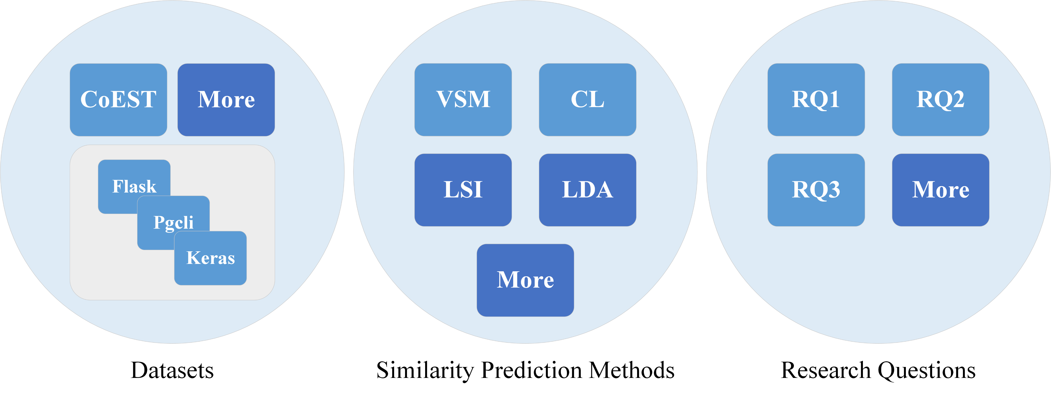
9. Future Work

Slide 18
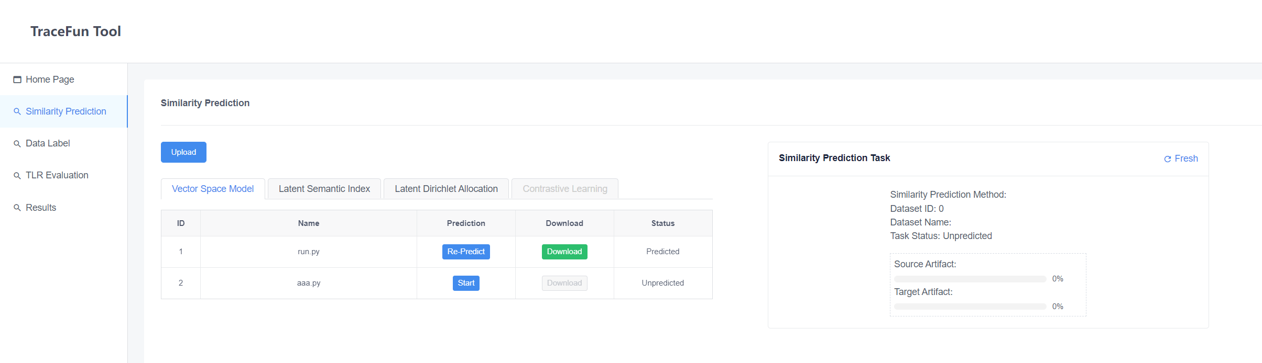
9. Future Work (Cont.)
Visualization Tool

Slide 19
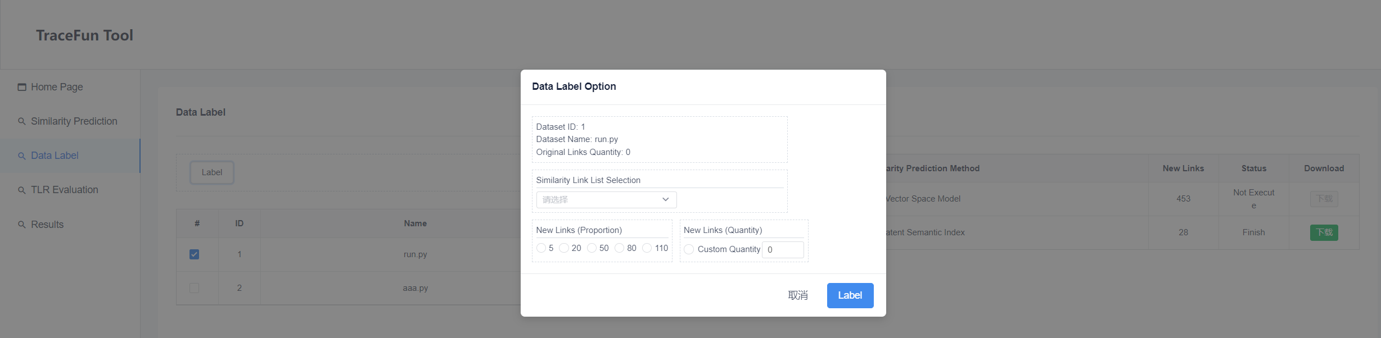
9. Future Work (Cont.)
Visualization Tool

Slide 20
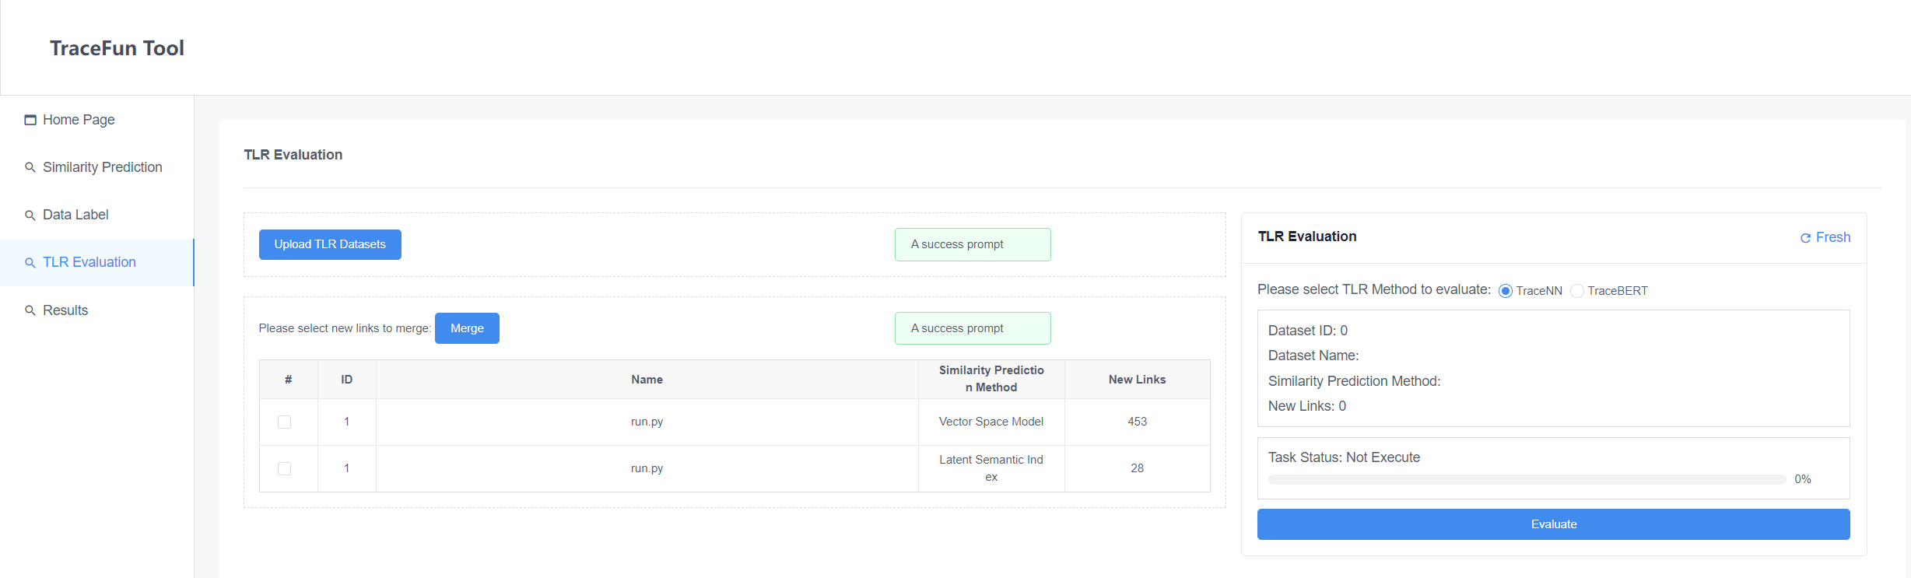
9. Future Work (Cont.)
Visualization Tool

Slide 21

ISSRE
2022
Thank you for your listening!
https://github.com/TraceFUN

